Slide 1
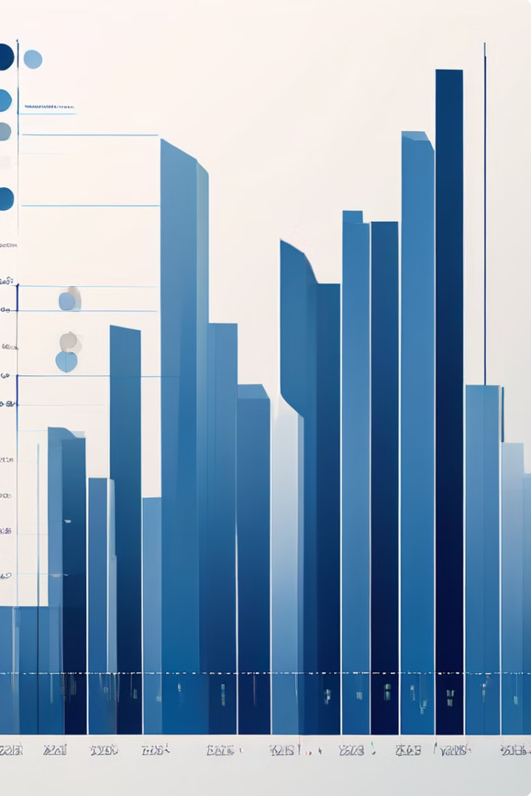
Data Analysis and Forecasting [Superstore]

Slide 2

Alaa Hesham sultan 20201027
1
2
Omar Salah Mohamed 20190354
Abdelfatah Gamal
3
20190671
4
Sara Samuel
20200217
Islam Nasser
5
20190669
Under Supervision of: Dr. Ghada Tolan

Slide 3

Agenda:
Introduction
problem statement and objective
Data Cleaning and Preprocessing
Exploratory Data Analysis
Data Visualization
Methodology
FUTURE WORK
CONCLUSION

Slide 4

Introduction
The "Superstore Sales Analysis and Prediction" project aims to leverage historical sales data from a global superstore to derive valuable insights and accurately forecast future sales. By employing data cleaning and feature engineering techniques, the project ensures high-quality data for analysis. Predictive modeling techniques, including Linear Regression and Random Forest, are utilized to develop robust sales forecasts. The project's ultimate goal is to provide actionable recommendations to enhance the superstore's operational efficiency, marketing strategies, and overall profitability.
This project examines four years of sales records from a global superstore to gain insights into sales dynamics, customer behavior, and product performance.

Slide 5

Problem Statement and Objective
Problem Statement
1
Clearly define the challenge or question you aim to answer.
2
Objective
Specify what you want to achieve with the analysis.

Slide 6
Problem Statement
The retail industry faces challenges in understanding sales fluctuations due to unpredictable market forces and customer behavior. A global superstore must base its decisions on data to effectively manage inventory, satisfy customers, and increase profitability. This project aims to apply statistical tools to historical sales data to uncover insights that aid business decision-making. The primary focus is on exploring sales trends, customer segmentation, product performance, sales forecasting, shipping and delivery impacts, regional sales differences, and profitability analysis.

Slide 7
Problem Statement and objective :
Sales Trends : Analyzing sales trends over a four-year period.
Customer Segmentation:Segmenting customers based on purchase behaviors.
Product Performance :Evaluating the performance of different product categories and sub-categories.
Sales Forecasting: Forecasting future sales for accurate inventory ordering.
Shipping and Delivery Impact : Assessing the impact of shipping modes and delivery times on customer satisfaction and sales.
Geographic Analysis: Comparing sales across different regions.
Profitability Analysis : identifying the most profitable product categories and customer segments.

Slide 8

Data Cleaning and Preprocessing
Data cleaning involves identifying and correcting errors, inconsistencies, and missing values in the dataset. Preprocessing transforms the data into a format suitable for analysis.
1
Data Collection
2
Data cleaning
3
Feature Engineering

Slide 9
Data Collection
We collected our data from sheets of Superstore Sales from the exports and imports sheets in America
the data consists of 9800 row and 18 columns

Slide 10
data cleaning:
1-Missing Values:
Dealing with missing data is crucial in data preprocessing, as missing values often result from corrupted information or data entry failures. In this dataset, the total missing values are minimal compared to the dataset size, allowing for an easier decision to ignore or drop these missing values during data cleaning.
Postal Code: 11 missing values All other columns have no missing values

Slide 11
2-Duplicated rows:
in this data sum of duplicated rows equal to zero
3-Correcting Data Types:
This step involves converting the data types of specific columns to appropriate formats. For instance: Order Date and Ship Date should be converted to datetime format.

Slide 12
Feature Engineering
1-Extracting Temporal Features
Temporal features can reveal important trends in time series data. In this project, we extract the Year and Month from the Order Date to capture seasonal and yearly trends.
2-Counting Products
A new custom feature, "amount_of_products," has been developed to quantify products across various sub-categories, enhancing insights into sales trends and inventory management requirements.
3-Calculating Revenue:
Revenue, a critical metric in sales data, is calculated by multiplying Sales by the "amount_of_products." This provides a straightforward measure of total earnings generated from product sales.

Slide 13
Exploratory Data Analysis
Category Data Overview
1-Order Details:
Order ID: 9,800 entries, 4,922 unique
Order Date: 9,800 entries, 1,230 unique
Ship Date: 9,800 entries, 1,326 unique
Ship Mode: 9,800 entries, 4 unique (most common: Standard Class)
Customer ID: 9,800 entries, 493 unique
Customer Name: 9,800 entries, 793 unique (most common: William Brown)
Segment: 9,800 entries, 3 unique (most common: Consumer)
Country: 9,800 entries, 1 unique (United States)

Slide 14
Geographic Data
Location Details:
City: 9,800 entries, 529 unique (most common: New York City)
State: 9,800 entries, 49 unique (most common: California)
Region: 9,800 entries, 4 unique (most common: West)
Product Details:
Product ID: 9,800 entries, 1,861 unique
Category: 9,800 entries, 3 unique (most common: Office Supplies)
Sub-Category: 9,800 entries, 17 unique (most common: Binders)
Product Name: 9,800 entries, 1,849 unique (most common: Staple envelope)

Slide 15
Numerical Data
Sales Data:
Row ID: 9,800 entries
Postal Code: 9,789 entries
Sales: 9,800 entries
Statistics:
Sales: Mean = 230.77, Std = 626.65, Min = 0.44, Max = 22638.48

Slide 16
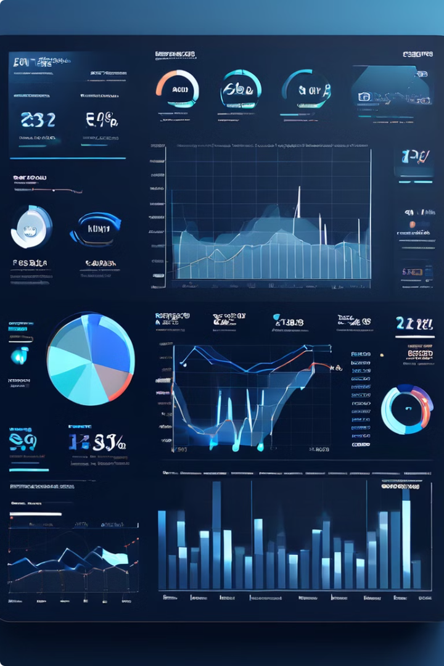
Data Visualization
Data visualization uses visual representations to convey insights and communicate findings effectively.
1
Charts and Graphs
Represent data relationships visually.
2
Analysis and problems
Visualize spatial data and trends , problems .
3
Dashboards
Provide a comprehensive overview of key metrics and insights.

Slide 17
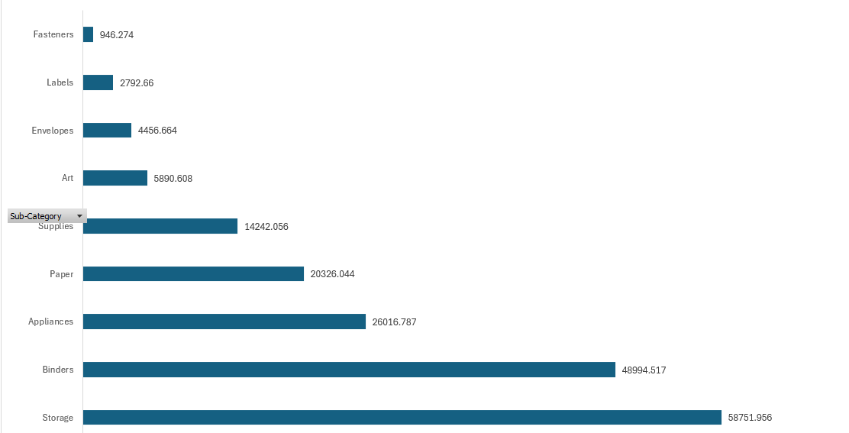
Notes
Office supplier is lowest in all years expect 2018 furniture is lowest
Office supplier → have a lot of product
fasteners
Suppliers
Labels
Envelopes
They have a marketing problem which has led to low sales. If they were replaced with better manufactured materials than the previous materials and marketed to them better, they could make sales develop significantly because they are half Office supplier

Slide 18
Fasteners , Labels
Have a Problem with the manufactured material or marketing in a south region specific
Art
Have a Problem with the manufactured material or marketing in a west region specific
Envelopes
Have a Problem with the manufactured material or marketing in a central region specific

Slide 19
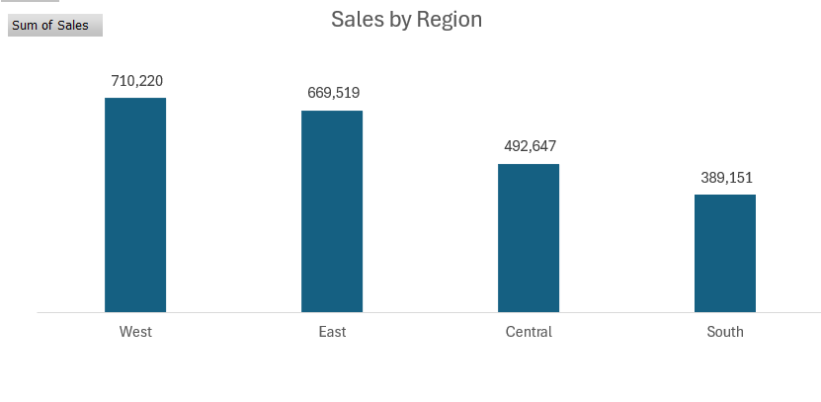
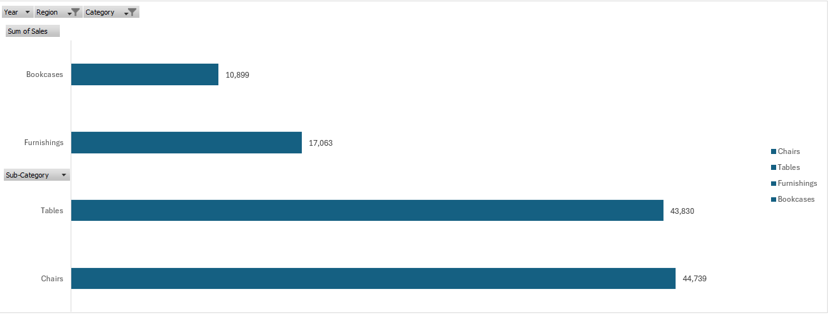
Sales pre region :
The lowest is south → also in furniture
We have problem with bookcases , furnishings

Slide 20
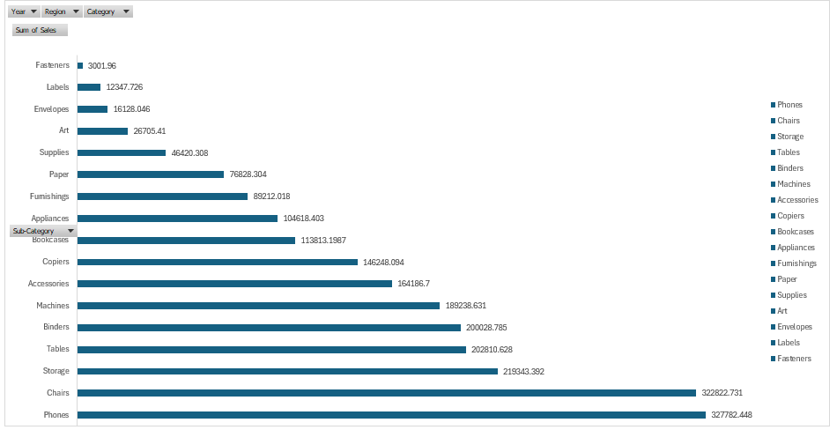
Sales for all years we have low sale in fasteners , labels , envelopes , art and supplies
Must focus in these product

Slide 21
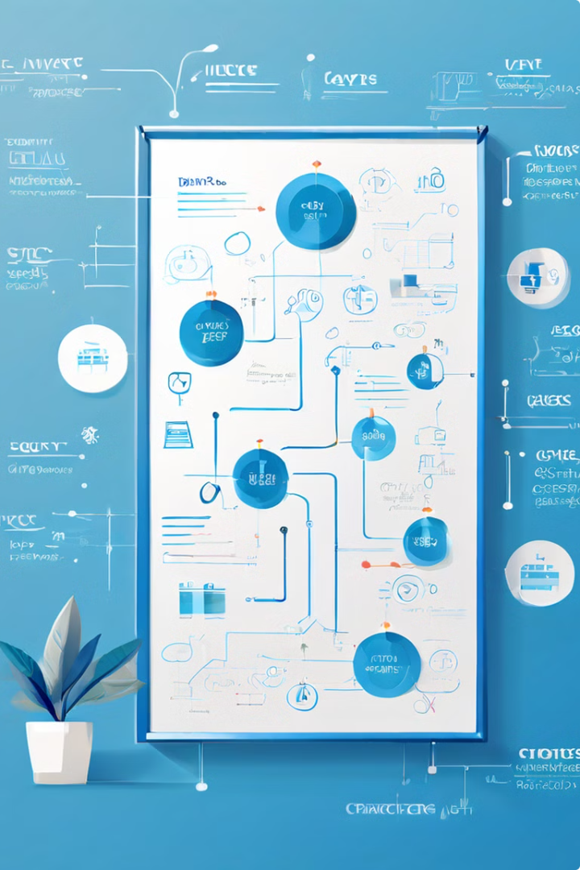


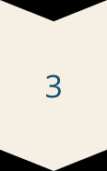

Methodology
The methodology outlines the specific techniques and models used for analysis and forecasting.
Linear Regression
Random Forest Regressor
Decision Tree Regressor
K-Nearest Neighbors (KNN)

Slide 22
Linear Regression:
Linear regression analysis is used to predict the value of a variable based on the value of another variable. The variable you want to predict is called the dependent variable. The variable you are using to predict the other variable's value is called the independent variable
Y i = β 0 + β 1 X I - y is the dependent variable. - β0​ is the y-intercept of the regression line. - β1​ is the slope of the regression line.

Slide 23
Real
Predict
1270
102.336
112.0084
272
5.280
5.7688
8308
37.170
36.0032
8494
6.080
6.0960
2784
23.976
23.9720
Accuracy: 37.56 %

Slide 24
Advantage
Disadvantage
Simplicity: Easy to understand and implement.
Linearity Assumption: Assumes a linear relationship, which may not always be true.
Efficiency: Computationally efficient for small to moderately sized datasets.
Outliers: Sensitive to outliers, which can skew results.
Interpretability: Coefficients indicate the strength and direction of relationships between variables.
Normality of Errors: Assumes normally distributed residuals.

Slide 25
Random Forest Regressor:
Random Forest Regressor is an ensemble learning method that operates by constructing multiple decision trees during training and outputting the average prediction of the individual trees. It is particularly useful for regression tasks due to its ability to model complex relationships and handle high-dimensional data.

Slide 26
Real
Predict
1270
102.336
102.13742
272
5.280
5.40474
8308
37.170
37.22408
8494
6.080
6.09593
2784
23.976
23.97122
Accuracy :92.88%

Slide 27
Advantage | Disadvantage
Accuracy: Generally provides better accuracy compared to individual decision trees by reducing overfitting. | Complexity: The model can become complex and harder to interpret compared to simpler models like linear regression.
Flexibility: Can handle both numerical and categorical data. | Computationally Intensive: Requires more computational resources and memory, especially with a large number of trees.
Feature Importance: Provides estimates of feature importance, which helps in feature selection. | Training Time: Can take longer to train compared to simpler models.

Slide 28
Decision Tree
Decision Tree Regressor is a type of supervised machine learning algorithm used for regression tasks. It models the target variable as a tree structure, where each internal node represents a decision based on a feature, each branch represents the outcome of a decision, and each leaf node represents a predicted value. The algorithm splits the data into subsets based on the feature that minimizes the error (such as mean squared error) at each step.

Slide 29
Real
Predict
1270
102.336
102.624
272
5.280
5.560
8308
37.170
37.312
8494
6.080
6.096
2784
23.976
23.976
: Accuracy: 87.40%

Slide 30
Advantage | Disadvantage
1- Easy to Understand and Interpret: Decision Trees are intuitive and easy to visualize. The tree structure makes it simple to interpret how decisions are made and which features are the most important. | 1- Overfitting: Decision Trees are prone to overfitting, especially when they grow too deep. They can create overly complex models that do not generalize well to new data.
2- Requires Little Data Preprocessing: Decision Trees can handle both numerical and categorical data. They do not require feature scaling or normalization. | 2- Unstable: Small changes in the data can result in significantly different tree structures, leading to high variance.
3- Handles Non-Linea Relationships: the target variable, making them versatile for various types of data. | 3- Poor Performance on Continuous Variables: Decision Trees can struggle with predicting continuous variables accurately compared to other regression techniques.
4- Handles Missing Values: Decision Trees can handle missing values in the data, making them robust to incomplete datasets. | 4- Optimal Splits: Finding the optimal split at each node can be computationally expensive, especially for large datasets with many features.

Slide 31
K-Nearest Neighbors (KNN)
K-Nearest Neighbors (KNN) Regressor is a supervised machine learning algorithm used for regression tasks. It predicts the value of a target variable by averaging the values of its k nearest neighbors in the feature space.
Real
Predict
1270
102.336
112.0084
272
5.280
5.7688
8308
37.170
36.0032
8494
6.080
6.0960
2784
23.976
23.9720
Accuracy: 37.56%

Slide 32
Advantage | Disadvantage
1-Simple and Intuitive: KNN Regressor is easy to understand and implement, making it accessible for beginners. | 1- Computational Complexity: Predicting new instances can be slow because it needs to compute distances to all training samples.
2- No Training Phase: Unlike parametric models, KNN Regressor does not require a training phase. It memorizes the training instances and makes predictions based on them directly. | 2- Memory Intensive: KNN Regressor requires storing all training data, which can be memory intensive for large datasets.
3- Non-Parametric: It is versatile and can handle on-linear data relationships. | 3- Sensitive to Outliers: It is sensitive to outliers in the data, which can significantly affect predictions.
4- No Assumptions About Data Distribution: KNN does not make any assumptions about the underlying data distribution. | 4- Need for Feature Scaling: KNN Regressor performs better when all features are on the same scale. Therefore, scaling of features is often necessary.

Slide 33
Linear Regression:
R-squared:
Moderate to high, depending on the linearity of the relationship in the data.
MAE:
Moderate
RMSE
Moderate.

Slide 34
Random Forest:
R-squared:
High
MAE:
Low.
RMSE
Low.

Slide 35
Decision Tree:
R-squared:
variable, often high on training data but lower on test data due to overfitting.
MAE:
Moderate
RMSE
Moderate to high.

Slide 36
K-Nearest Neighbors (KNN):
R-squared:
Moderate to high, depending on the choice of K and scaling of data.
MAE:
Low to moderate.
RMSE
Low to moderate.

Slide 37
Summary
Best Performing Model: Random Forest, with the highest accuracy, indicating it is the most suitable model for the dataset in question.
Poor Performing Models: Linear Regression and KNN, both with very low accuracy, suggesting they are not suitable for this dataset.

Slide 38

FUTURE WORK
While this project has laid a solid foundation for superstore sales analysis and prediction, there are several avenues for future work that can build upon our findings and further enhance the project
Model Improvement
Real-time Data Processing
Feature Selection and Engineering:
Integration with Business Systems
Time Series Analysis:
Enhanced Visualization

Slide 39
Conclusion
Key findings and achievements from this project include
Comprehensive Data Exploration and Cleaning
1
Thorough data cleaning and preprocessing to ensure data quality and reliability.
2
Insightful Data Visualization
Leveraging effective data visualizations to uncover meaningful insights.
Effective Feature Engineering
3
Transforming raw data into relevant features to enhance model performance.
4
Model Implementation and Evaluation
Applying appropriate machine learning models and evaluating their effectiveness.
Business Implications
5
Interpreting the results to derive actionable insights for the business.

Slide 40

thank you
We are grateful for your continued support .

